Slide 1

CC 141 Discrete Structures Department of Computer Science School of Systems and Technology University of Management and Technology Lahore, Pakistan

Slide 2
Section No. 2.4 Sequence & Summations

Slide 3
APPLICATION OF SEQUENCES AND SUMMATIONS
Sequence and Summations has multiple applications in computer science
Algorithm Analysis
Recursion & Dynamic Programming
Data Structures
Graphics and Animation
Cryptography
Database Query Optimization
Machine Learning & AI

Slide 4
SEQUENCE
SEQUENCE:
A sequence is just a list of elements usually written in a row.
EXAMPLES:
1). 1, 2, 3, 4, 5, …
2). 4, 8, 12, 16, 20,…
3). 2, 4, 8, 16, 32, …
4). 1, 1/2, 1/3, 1/4, 1/5, …
5). 1, 4, 9, 16, 25, …
6). 1, -1, 1, -1, 1, -1, …
Note:
The symbol “…” is called ellipsis, and reads “so forth”

Slide 5
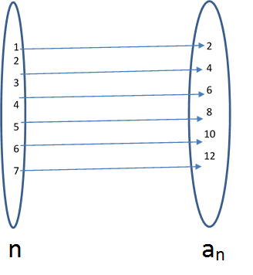
Sequence
A sequence is an ordered list of items.
It may be imagined as a function mapped from elements of set N to elements of set S.
We use the notation a_{n} to denote the image of the integer n, and call it a term of the sequence. Thus
a₁, a₂, a₃, a₄ …, a_{n}, …
represent the terms of a sequence defined on the set of natural numbers N.
Example:
a_{n} = 2n shows a sequence as image
image of (1) = 2
image of (2) = 4
image of (3) = 6
image of (4) = 8
image of (5) = 10

Slide 6
FORMAL DEFINITION OF SEQUENCE
A sequence is a function whose domain is the set of integers greater than or equal to a particular integer n₀
Usually this set is the set of Natural numbers {1, 2, 3, …} or the set of whole numbers {0, 1, 2, 3, …}.

Slide 7
FINDING TERMS OF A SEQUENCE GIVEN BY AN EXPLICIT FORMULA
An explicit formula or general formula for a sequence is a rule that shows how the values of a_{k} depends on k.
Example
Define a sequence a₁, a₂, a₃, … by the explicit formula, find the first 4th term of the sequence:
To find the 1st term just replace k with 1 and so on…

Slide 8
EXAMPLE
Write the first four terms of the sequence defined by the formula b_{j} = 1 + 2^{j}, for all integers j ≥ 0
SOLUTION:
b₀ = 1 + 2⁰ = 1 + 1 = 2
b₁ = 1 + 2¹ = 1 + 2 = 3
b₂ = 1 + 2² = 1 + 4 = 5
b₃ = 1 + 2³ = 1 + 8 = 9
REMARK:
The formula b_{j} = 1 + 2^{j}, for all integers j ≥ 0 defines an infinite sequence having infinite number of values.

Slide 9
EXAMPLE
Compute the first six terms of the sequence defined by the formula C_{n} = 1+ (-1) ^{n} for all integers n ≥ 0
SOLUTION:
C₀ = 1 + (-1)⁰ = 1 + 1 = 2
C₁ = 1 + (-1)¹ = 1 + (-1) = 0
C₂ = 1 + (-1)² = 1 + 1 = 2
C₃ = 1 + (-1)³ = 1 + (-1) = 0
C₄ = 1 + (-1)⁴ = 1 + 1 = 2
C₅ = 1 + (-1)⁵ = 1 + (-1) = 0

Slide 10
EXAMPLE
Write the first four terms of the sequence defined by
SOLUTION:
REMARK:
A sequence whose terms alternate in sign is called an alternating sequence.

Slide 11
EXERCISE
Find explicit formulas for sequences with the initial terms given:
1). 0, 1, -2, 3, -4, 5, …
2).
3). 2, 6, 12, 20, 30, 42, 56, …
4). 1/4, 2/9, 3/16, 4/25, 5/36, 6/49, …

Slide 12
Solution
1). 0, 1, -2, 3, -4, 5, …
SOLUTION:
Its an alternating sequence. In alternating sequence always take the power of (-1)
a_{n} = (-1) ^{n+1}n for all integers n ≥ 0
when n is odd the term will become positive.
Check:
a₀ = (-1) ^{0+1.}0 = 0, a₁ = (-1) ¹⁺¹1 = 1,
a₂ = (-1) ^{2+1.}2 = -2, a₃ = (-1) ^{3+1.}3 = 3,
a₄ = (-1) ^{4+1.}4 = -4, a₅ = (-1) ^{5+1.}5 = 5,

Slide 13
Solution
2).
SOLUTION:
Every term has two parts:
b₁ = b₂ =
b₃ =
General term is:

Slide 14
Solution
3). 2, 6, 12, 20, 30, 42, 56, …
SOLUTION:
Note that we can write
C₁ = 1.2 = 2 C₂ = 2.3 = 6
C₃ = 3.4 = 12 C₄ = 4.5 = 20
In general n^{th} term is
C_{n} = n.(n+1) for all integers n ≥ 1

Slide 15
Solution
4). 1/4, 2/9, 3/16, 4/25, 5/36, 6/49, …
SOLUTION:
Every term has two parts numerator and denominator.
OR
Both defined the same sequences.

Slide 16
ARITHMETIC SEQUENCE
A sequence in which every term after the first is obtained from the preceding term by adding a constant number is called an arithmetic sequence or arithmetic progression (A.P.)
The constant number, being the difference of any two consecutive terms is called the common difference of A.P., commonly denoted by “d”.
EXAMPLES
1. 5, 9, 13, 17, … (First Term = 5, Common Difference = 4)
2. 0, -5, -10, -15, … (First Term = 0, Common Difference = -5)
3. x + a, x + 3a, x + 5a, … (First Term = x+a, Common Difference = 2a)

Slide 17
GENERAL TERM OF AN ARITHMETIC SEQUENCE
Let a be the first term and d be the common difference of an arithmetic sequence. Then the sequence is
a₁ = a
a₂ = a+d
a₃ = a+2d
a₄ = a+3d …
a₁ = a = a + (1-1) d
a₂ = a + d = a + (2-1) d
a₃ = a + 2d = a + (3 -1) d
By symmetry
a_{n} = n^{th} term = a + (n - 1)d for all integers n ≥1.

Slide 18
EXAMPLE
Find the 20th term of the arithmetic sequence
3, 9, 15, 21, …
SOLUTION:
Here a = first term = 3
d = common difference = 9 - 3 = 6
n = term number = 20
a₂₀ = value of 20th term = ?
Since a_{n} = a + (n - 1) d n ≥1
∴ a₂₀ = 3 + (20 - 1) 6
= 3 + 114
= 117

Slide 19
EXAMPLE
Which term of the arithmetic sequence
4, 1, -2, …, is -77
SOLUTION:
Here a = first term = 4; d = common difference = 1 - 4 = -3
a_{n} = value of nth term = -77 n = term number = ?
Since a_{n} = a + (n - 1) d n ≥1
⇒ -77 = 4 + (n - 1) (-3)
⇒ -77 - 4 = (n - 1) (-3)
⇒
⇒ 27 = n – 1
n = 28
Hence –77 is the 28th term of the given sequence.

Slide 20
EXERCISE
Find the 36th term of the arithmetic sequence whose 3rd term is 7 and 8th term is 17.
SOLUTION:
Let a be the first term and d be the common difference of the arithmetic sequence.
Then
a_{n} = a + (n - 1)d n ≥ 1
⇒ a₃ = a + (3 - 1) d
and a₈ = a + (8 - 1) d
Given that a₃ = 7 and a₈ = 17.
Therefore,
7 = a + 2d……………………(1)
and 17 = a + 7d………….………..(2)

Slide 21
Subtracting (1) from (2), we get,
10 = 5d
⇒ d = 2
Substituting d = 2 in (1) we have
7 = a + 2(2)
which gives a = 3
Thus, a_{n} = a + (n - 1) d
a_{n} = 3 + (n - 1) 2 (using values of a and d)
Hence the value of 36th term is
a₃₆ = 3 + (36 - 1) 2
= 3 + 70
= 73

Slide 22
GEOMETRIC SEQUENCE
A sequence in which every term after the first is obtained from the preceding term by multiplying it with a constant number is called a geometric sequence or geometric progression (G.P.)
The constant number, being the ratio of any two consecutive terms is called the common ratio of the G.P. commonly denoted by “r”.
EXAMPLES
1, 2, 4, 8, 16, … (First Term = 1; Common Ration = 2)
3, - 3/2, 3/4, - 3/8, … (First Term = 3; Common Ration = -1/2)
0.1, 0.01, 0.001, 0.0001, … (First Term = 0.1; Common Ration = 1/10)

Slide 23
GENERAL TERM OF A GEOMETRIC SEQUENCE
Let a be the first tem and r be the common ratio of a geometric sequence.
Then the sequence is
a , ar , ar², ar³, …
a₁ = first term = a = ar¹⁻¹
a₂ = second term = ar = ar²⁻¹
a₃ = third term = ar² = ar³⁻¹
………………
………………
a_{n} = nth term = ar^{n-1}; for all integers n ≥ 1

Slide 24
EXAMPLE
Find the 8th term of the following geometric sequence
4, 12, 36, 108, …
SOLUTION:
Here a = first term = 4
r = common ratio = = 3
n = term number = 8
a₈ = value of 8th term = ?
Since a_{n} = ar^{n-1} n ≥ 1
⇒ a₈ = (4)(3)⁸⁻¹
= 4 .(2187)
= 8748

Slide 25
EXAMPLE
Which term of the geometric sequence is 1/8 if the first term is 4 and common ratio ½
SOLUTION:
Given a = first term = 4 r = common ratio = ½
a_{n} = value of the nth term = 1/8 n = term number = ?
Since a_{n} = ar^{n-1} n ≥ 1
Since bases are same so powers must be equal
⇒ n – 1 = 5
⇒ n = 6
Hence 1/8 is the 6th term of the given G.P.

Slide 26
EXAMPLE
Write the geometric sequence with positive terms whose second term is 9 and fourth term is 1.
SOLUTION:
General Formula
a_{n} = ar ^{n-1} n ≥1
Now
a₂ = ar ²⁻¹
⇒ 9 = ar ……………….(1)
Also a₄ = ar⁴⁻¹
⇒ 1 = ar ³ ………………(2)
Dividing (2) by (1), we get,

Slide 27
Substituting r = 1/3 in (1), we get
Hence the geometric sequence is
27, 9, 3, 1, 1/3, 1/9, …

Slide 28
SUMMATION

Slide 29

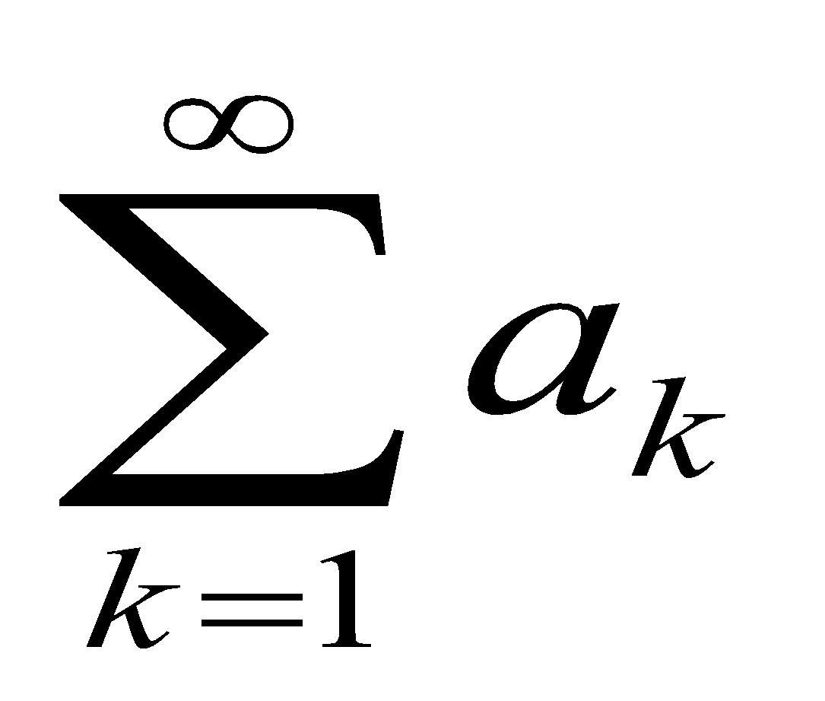
INTRODUCTION
The sum of the terms of a sequence forms a series. If
a₁, a₂, a₃, …
represent a sequence of numbers, then the corresponding series is:
a₁ + a₂ + a₃ + …
The capital Greek letter sigma ∑ is used to write a sum in a short hand notation.
= a₁ + a₂ + a₃ + … + a_{n}
Here k is called the index of the summation, varies from 1 to n.
=

Slide 30
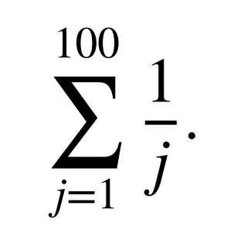
COMPUTING SUMMATIONS
Use summation notation to express the sum of the first 100 terms of the sequence {a_{j}}, where
a_{j} = 1/j for j = 1, 2, 3, … .
SOLUTION
Lower limit of the summation is 1.
Upper limit of the summation is 100.
We write the Sum as:

Slide 31
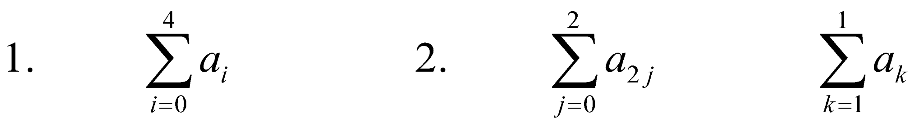
COMPUTING SUMMATIONS
Let a₀ = 2, a₁ = 3, a₂ = -2, a₃ = 1 and a₄ = 0.
Compute each of the summations:
3.

Slide 32
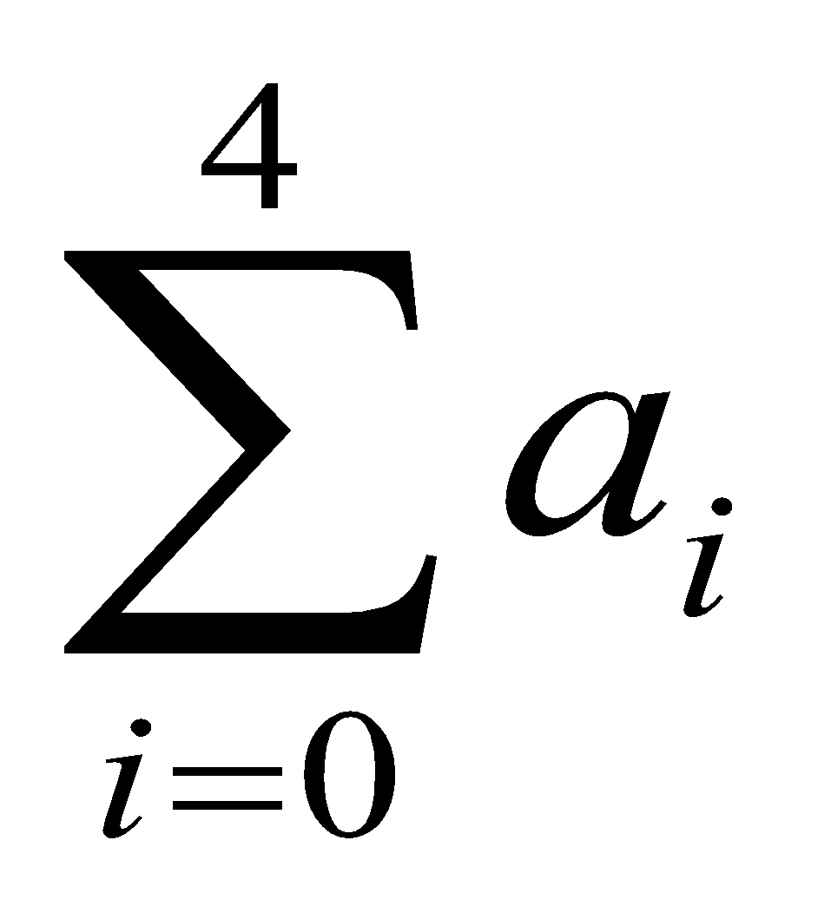
Example 1
Let a₀ = 2, a₁ = 3, a₂ = -2, a₃ = 1 and a₄ = 0
Compute
SOLUTION
We will take i = 0, 1, 2, 3, 4
= a₀ + a₁ + a₂ + a₃ + a₄
= 2 + 3 + (-2) + 1 + 0
= 4

Slide 33
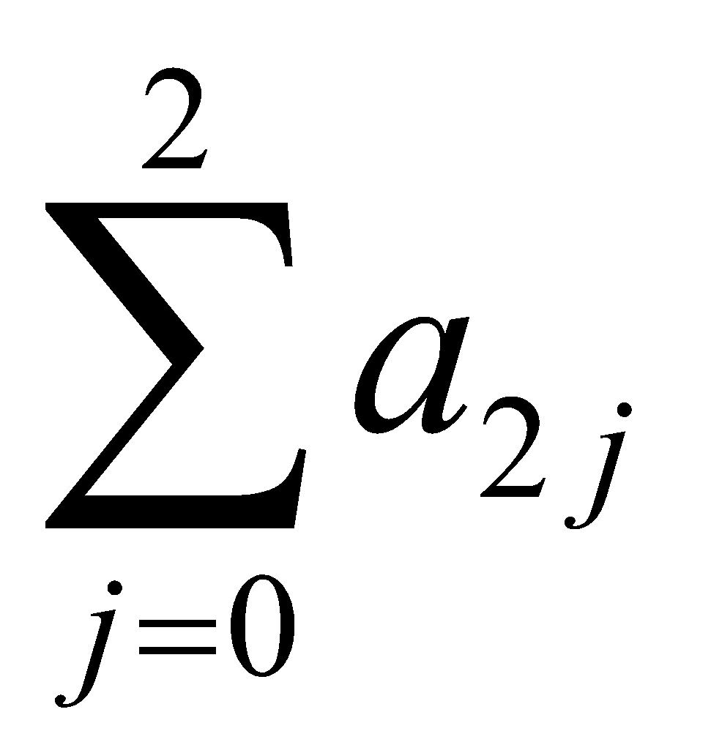
Example 2
Let a₀ = 2, a₁ = 3, a₂ = -2, a₃ = 1 and a₄ = 0
Compute
SOLUTION
= a₀ + a₂ + a₄ (Take j = 0, 1, 2)
= 2 + (-2) + 0
= 0

Slide 34
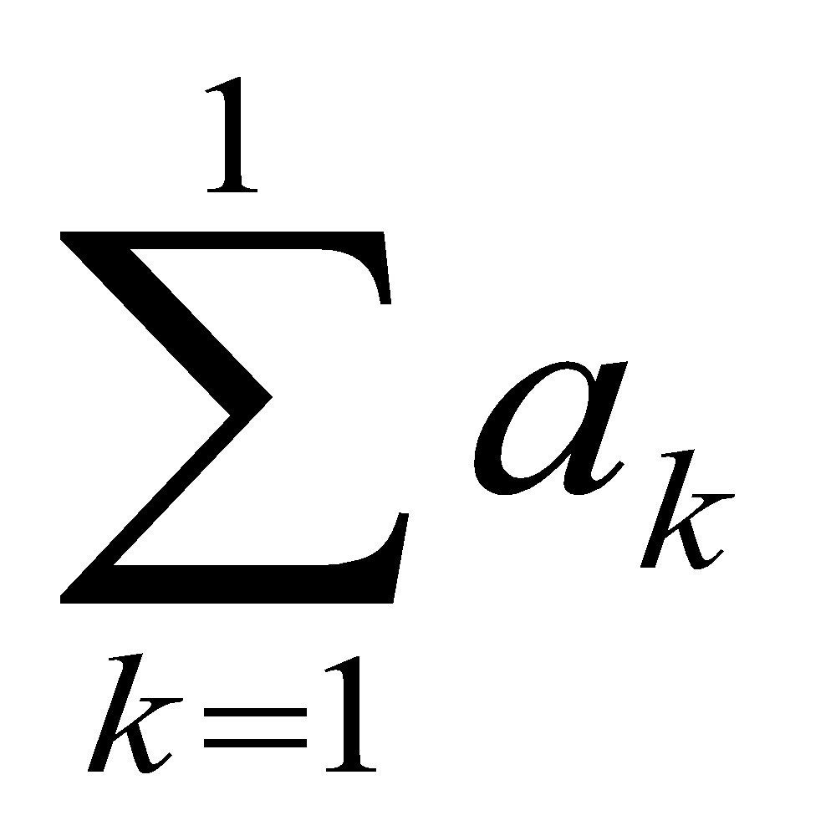
Example 3
Let a₀ = 2, a₁ = 3, a₂ = -2, a₃ = 1 and a₄ = 0
Compute
SOLUTION
= a₁ (As k = 1)
= 3

Slide 35
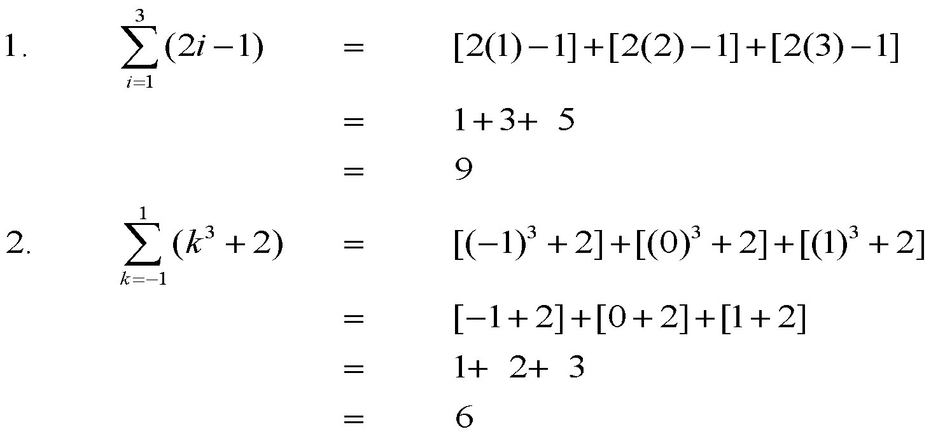
EXERCISE
Compute the summations.

Slide 36
NOTE
Note that in both the examples we have constants.
In First example we have constant ‘-1’ that constant appear in all three terms.
Similarly ‘+2’ in the second example.
The constant term in series keep on adding.

Slide 37
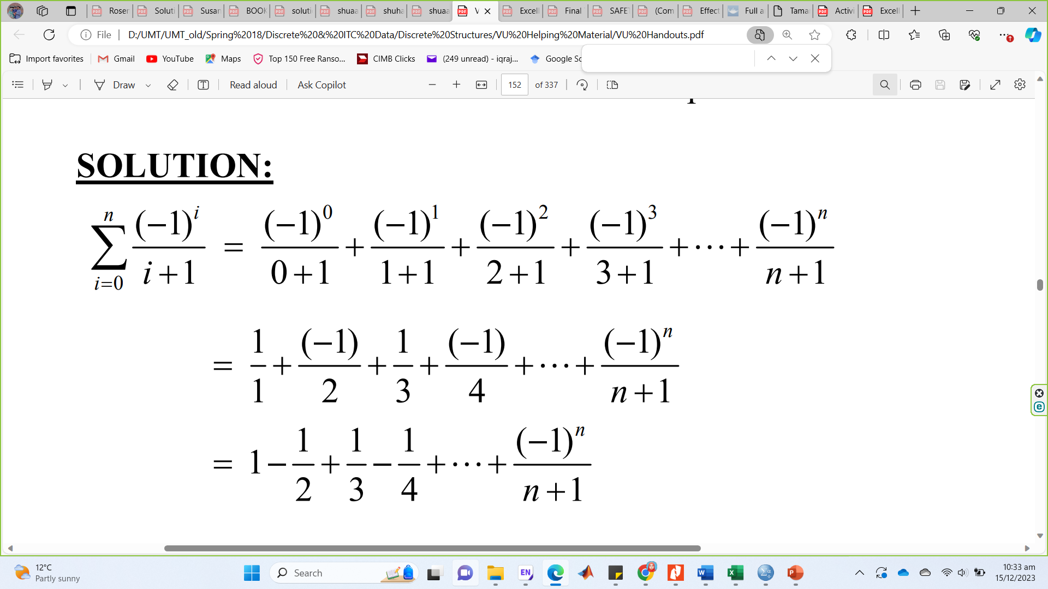
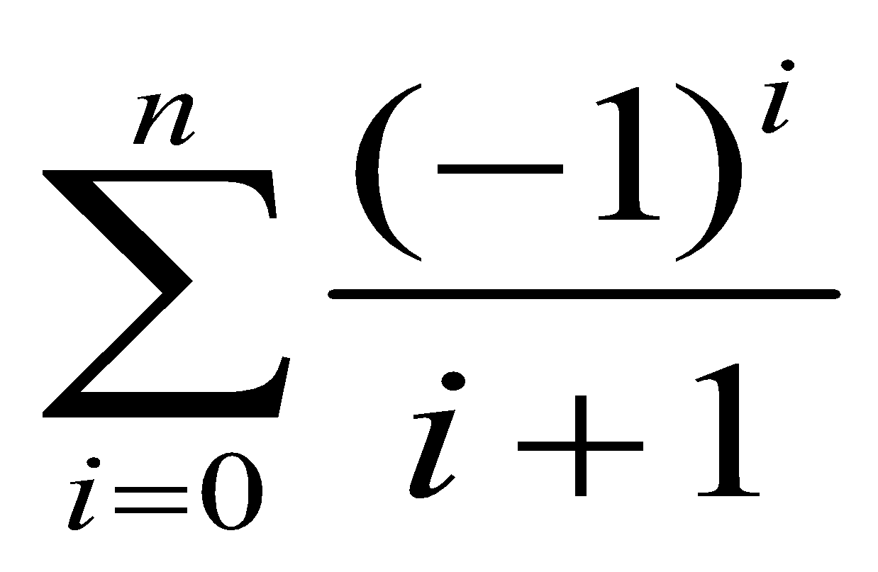
SUMMATION NOTATION TO EXPANDED FORM
Write the summation to expanded form:
SOLUTION:
Lower Limit = 0, Upper Limit = n
Total number of terms will be n + 1.

Slide 38
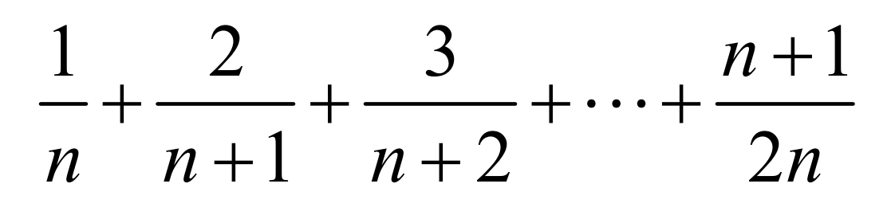
EXPANDED FORM TO SUMMATION NOTATION
Write the following using summation notation:
SOLUTION
1, 2, 3,…, n+1 are Numerators
The numerators forms an arithmetic sequence
a = first term = 1
& d = common difference = 1
So, For Numerator the k^{th} term will be:
a_{k} = a + (k - 1)d
= 1 + (k - 1) (1)
= 1 + k - 1
a_{k} = k

Slide 39
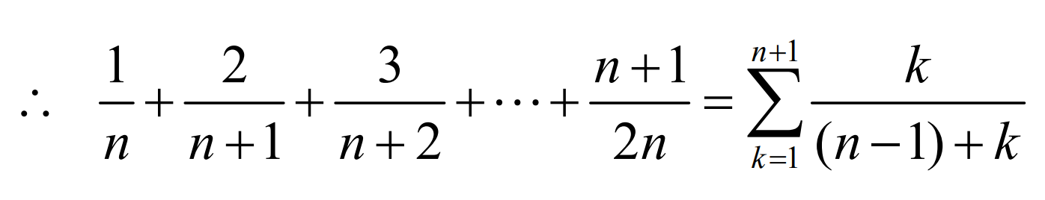
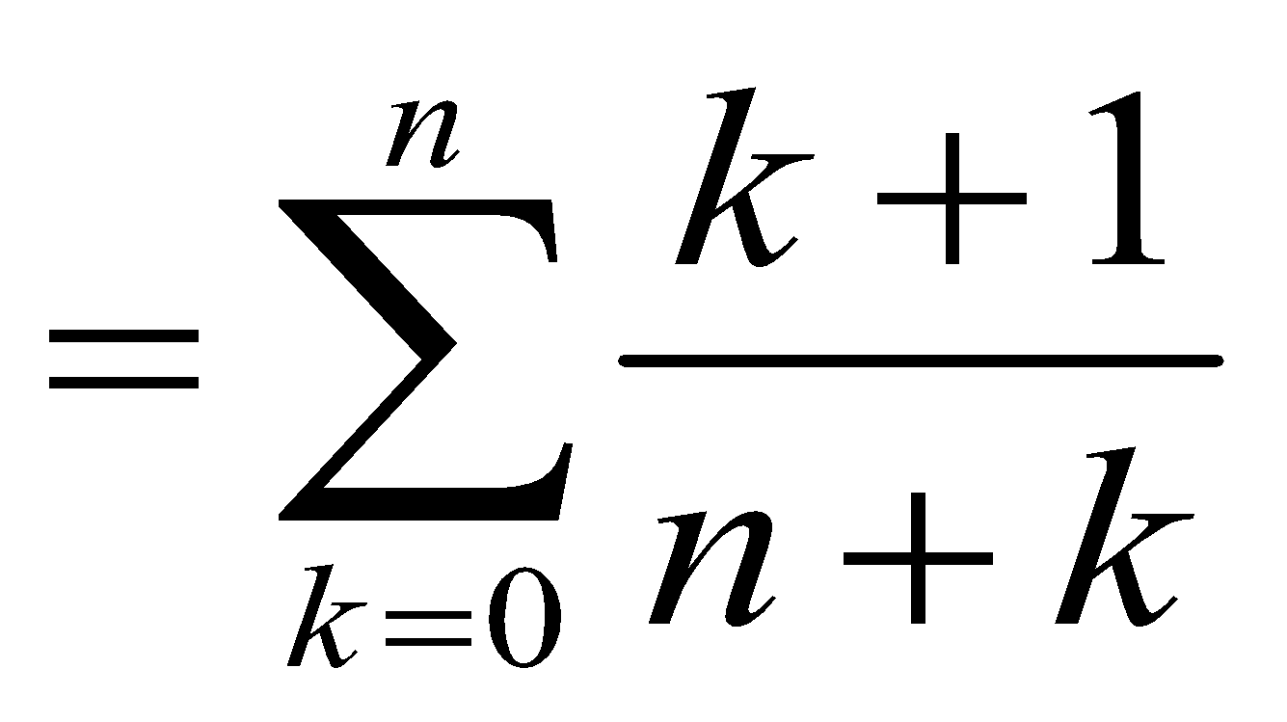
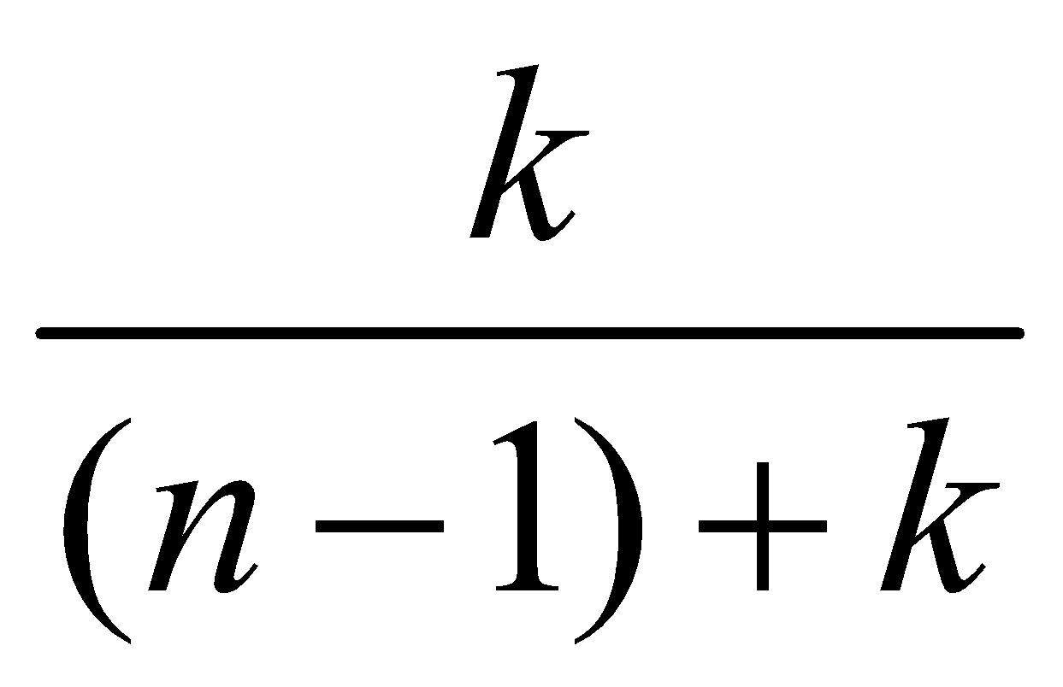
n, n+1, n+2, …, 2n are Denomenators.
Similarly, denominators forms an arithmetic sequence
a = first term = n d = common difference = 1
So, For Denominator the k^{th} term will be:
a_{k} = a + (k - 1)d
= n + (k - 1) (1)
a_{k} = k + n – 1
Hence the kth term of the series is
And the expression for the series is given by

Slide 40
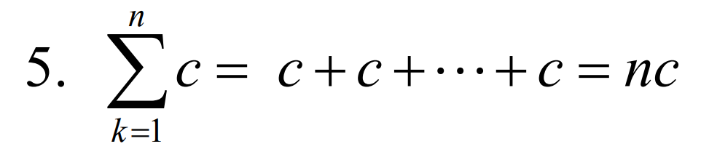
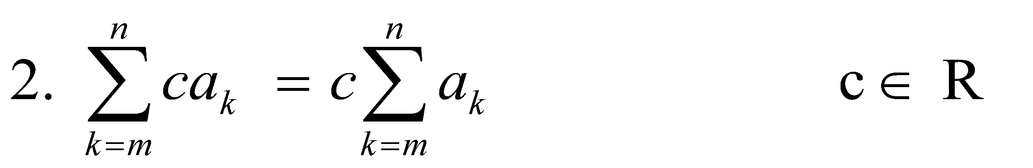
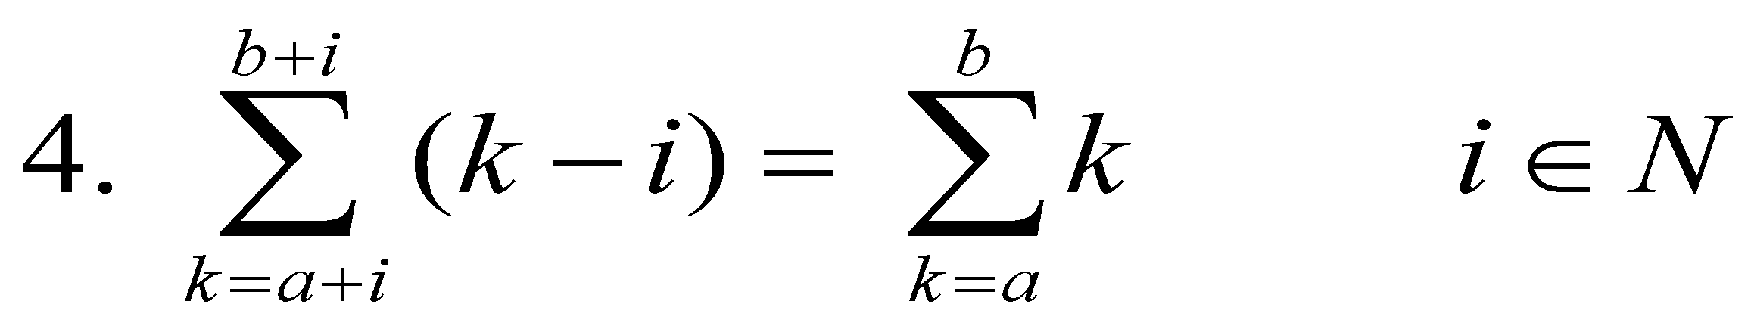
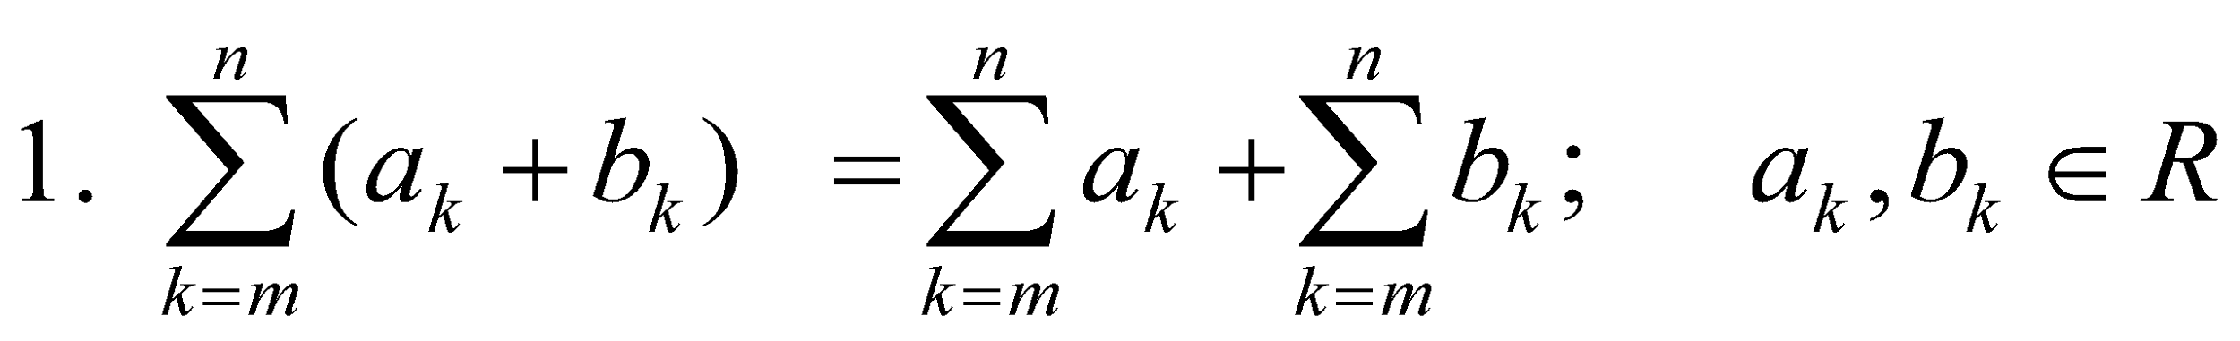
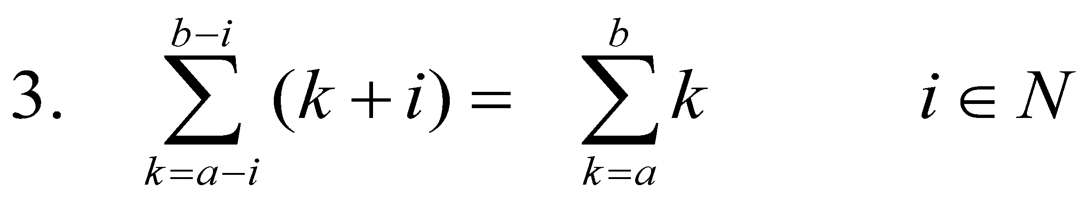
PROPERTIES OF SUMMATIONS

Slide 41
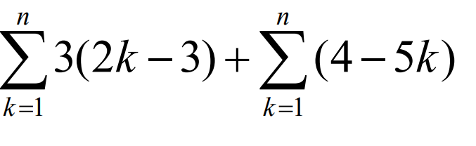
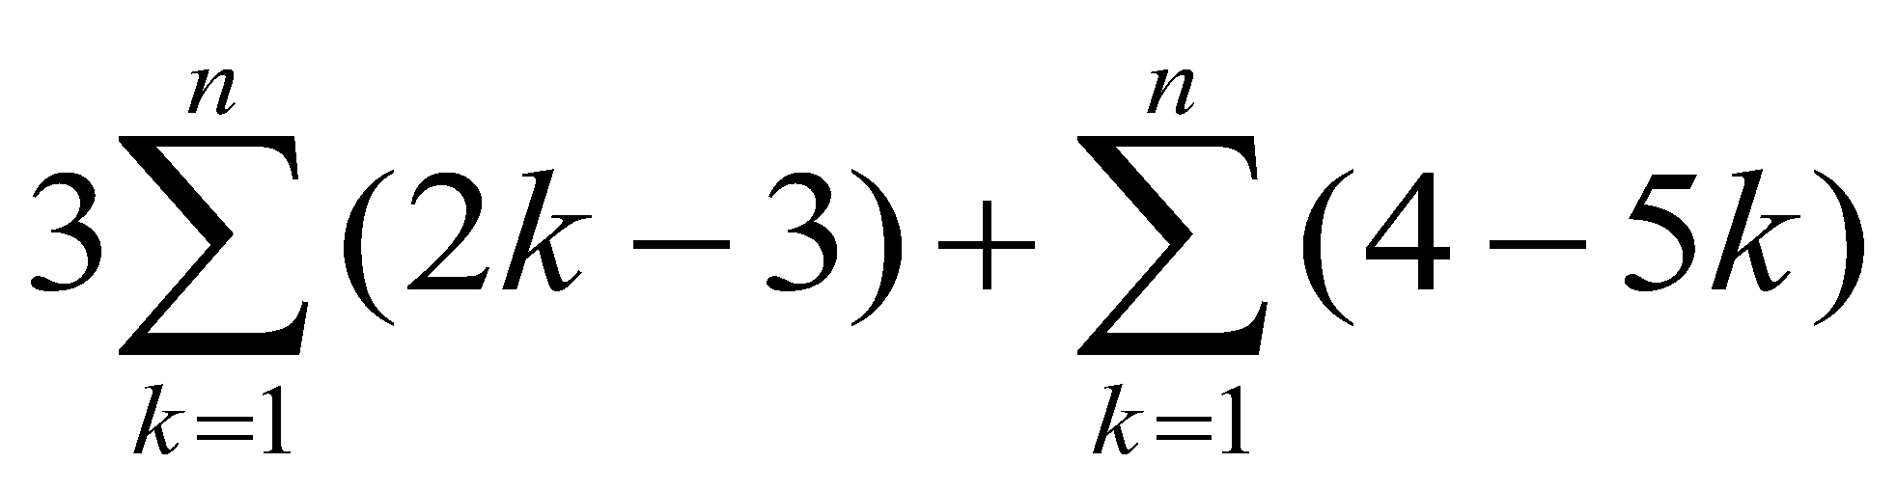
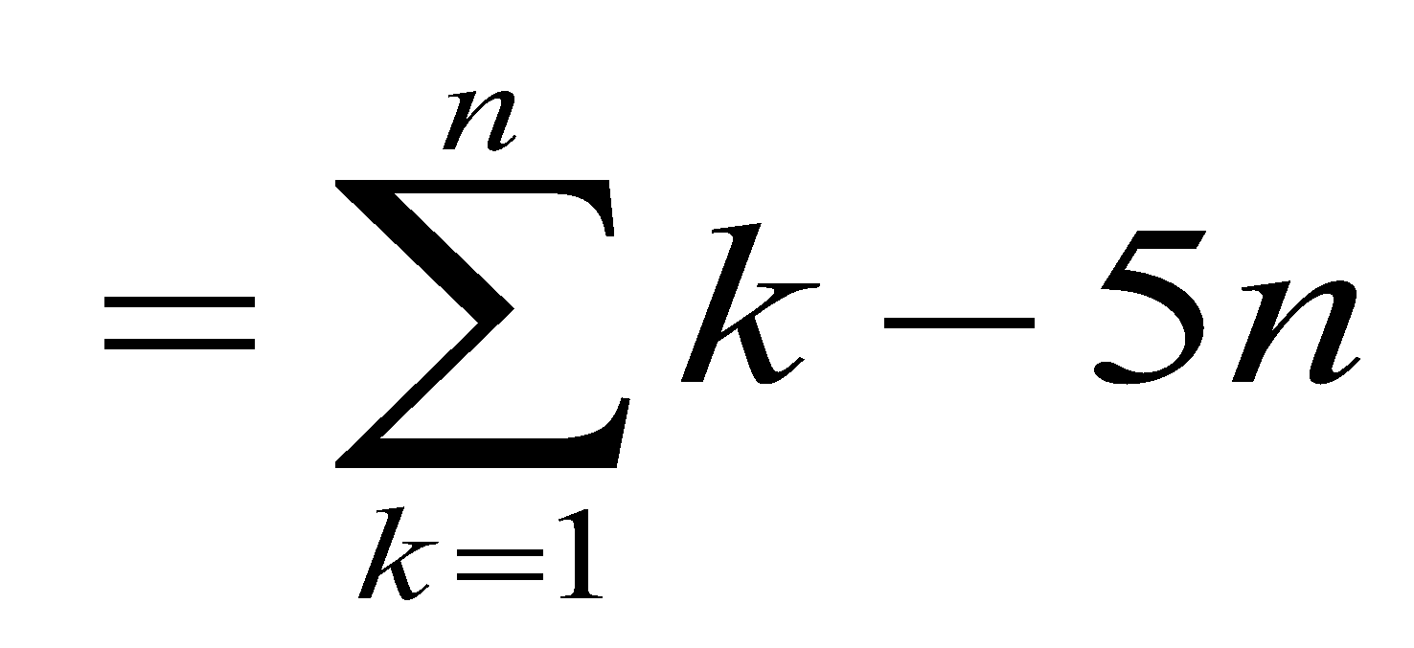
EXERCISE
Express the following summation more simply:
SOLUTION:
=
=

Slide 42
Summation Properties: Exercise …… Do it Yourself
Solution?

Slide 43
Summation Properties: Exercise …… Do it Yourself
Solution?

Slide 44
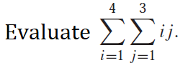
Summation Properties: Exercise …… Do it Yourself
Solution?

Slide 45
ARITHMETIC SERIES
The sum of the terms of an arithmetic sequence forms an arithmetic series (A.S).
For example:
Arithmetic sequence is 1 , 3 , 5 , 7 , …
Then
1 + 3 + 5 + 7 + …
is an arithmetic series of positive odd integers.
In general, if a is the first term and d the common difference of an arithmetic series, then the series is given as:
a + (a+d) + (a+2d) +…

Slide 46
SUM OF n TERMS OF AN ARITHMETIC SERIES
Let a be the first term and d be the common difference of an arithmetic series. Then its nth term is:
a_{n} = a + (n - 1)d; n ≥ 1
If S_{n} denotes the sum of first n terms of the A.S, then
S_{n} = a + (a + d) + (a + 2d) + … + [a + (n-1) d]
= a + (a+d) + (a + 2d) + … + a_{n} Where a_{n} = a + (n - 1)d
= a + (a+d) + (a + 2d) + … + (a_{n} - d) + a_{n} …(1)
Rewriting the terms in the series in reverse order.
S_{n} = a_{n} + (a_{n} - d) + (a_{n} - 2d) + … + (a + d) + a ……….(2)
Adding (1) and (2) term by term, gives
2S_{n} = (a + a_{n}) + (a + a_{n}) + (a + a_{n}) + … + (a + a_{n}) (n terms)
2S_{n} = n(a + a_{n})
S_{n} = n(a + a_{n})/2
S_{n} = n(a + l)/2…………………..(3) (l=last term)
If we write a_{n} = a + (n - 1)d
S_{n}= n/2 [a + a + (n - 1) d]
S_{n} = n/2 [2 a + (n - 1) d]……….(4)

Slide 47
Hence,
We have two formulas for finding a sum.
S_{n} = n(a +I )/2 …………..(1)
We use it when we are given first term a and the last term l .
S_{n} = n/2 [2a + (n - 1) d] ...................(2)
We will use it when first term and common difference is given.

Slide 48
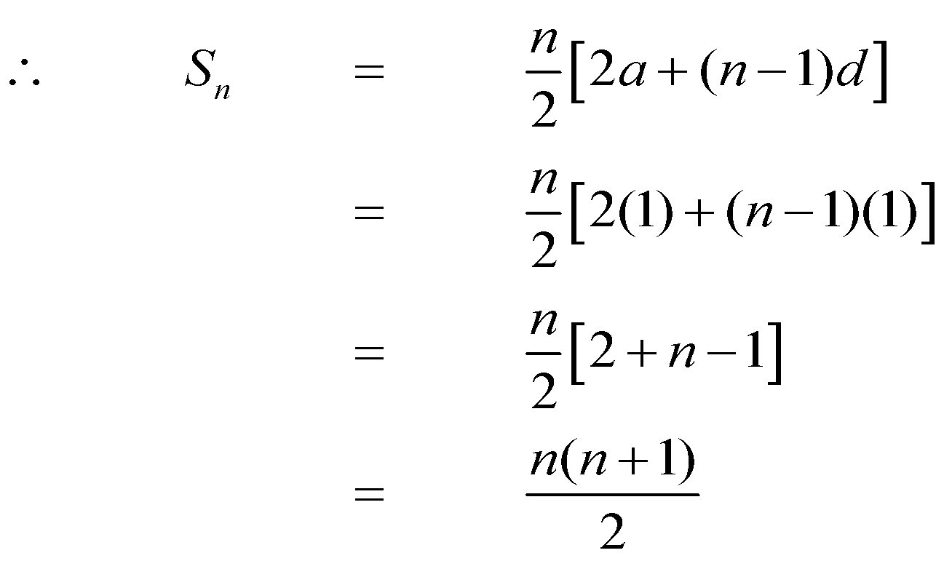
EXERCISE
Find the sum of first n natural numbers.
SOLUTION
Let S_{n} = 1 + 2 + 3 + … + n
Clearly the right-hand side forms an arithmetic series with
a = 1, d = 2 - 1 = 1 and n = n

Slide 49
EXERCISE
Find the sum of all two digit positive integers which are neither divisible by 5 nor by 2.
SOLUTION
S_{n} =(11 + 13 + 15 + …. +99)–(15 + 25 + 35 +…..+ 95) which is not an arithmetic series.
However,
11 + 21 + 31 + ……… + 91 is an arithmetic series. with a = 11, d = 10
13 + 23 + 33 + ……… + 93 is an arithmetic series. with a = 13, d = 10
17 + 27 + 37 + ……… + 97 is an arithmetic series with a = 17, d = 10
19 + 29 + 39 + ……… + 99 is an arithmetic series. with a = 19, d = 10
If we make group of four terms we get
(11 + 13 + 17 + 19) + (21 + 23 + 27 + 29) + (31 + 33 + 37 + 39) + … + (91 + 93 + 97 + 99)
= 60 + 100 + 140 + … + 380 which now forms an arithmetic series in which
a = 60; d = 100 - 60 = 40 and l = a_{n} = 380

Slide 50
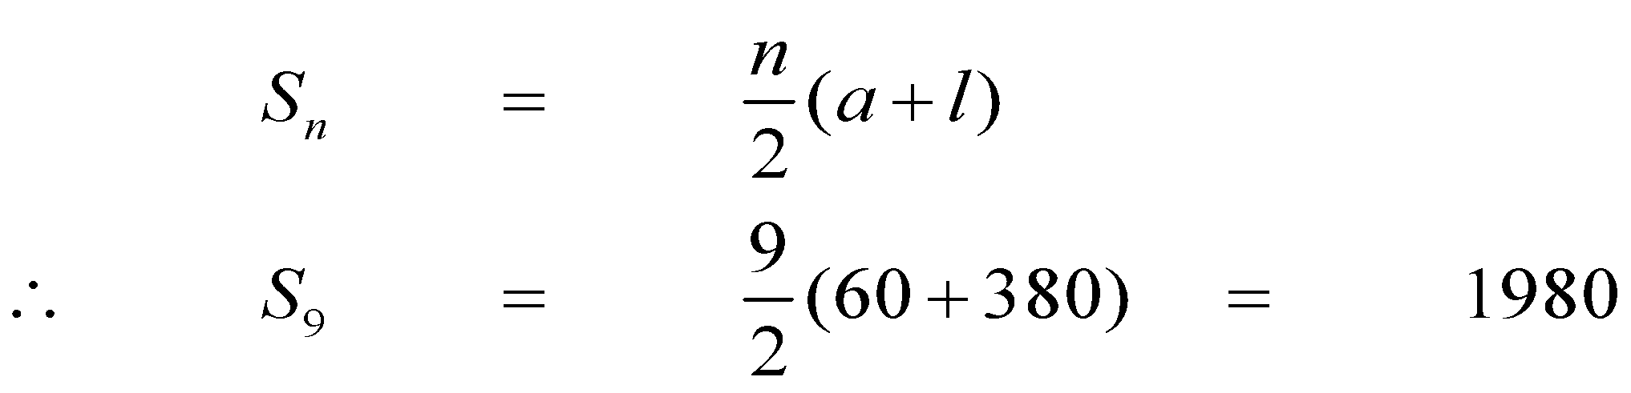
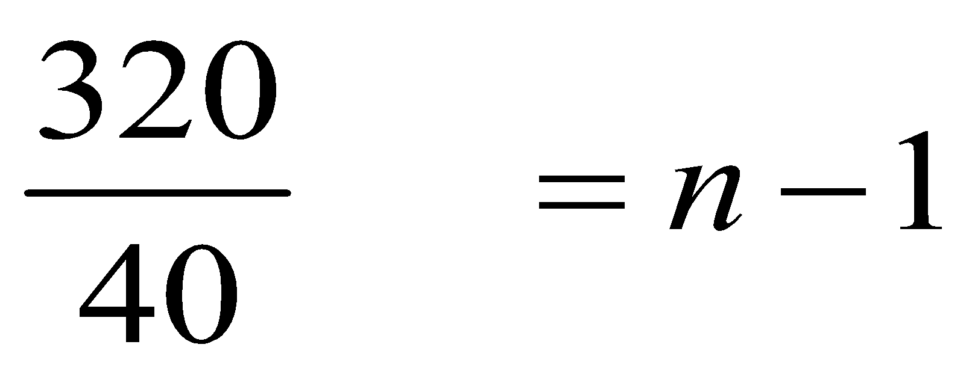
To find n, we use the formula
a_{n} = a + (n - 1) d
⇒ 380 = 60 + (n - 1) (40)
⇒ 380 - 60 = (n - 1) (40)
⇒ 320 = (n - 1) (40)
8 = n - 1
⇒ n = 9
Now
a = 60 1 = a_{n} = 380 n = 9

Slide 51
GEOMETRIC SERIES
The sum of the terms of a geometric sequence forms a geometric series (G.S.).
For example
Geometric Sequence
1, 2, 4, 8, 16, …
Geometric Series
1 + 2 + 4 + 8 + 16 + …
In general, if a is the first term and r the common ratio of a geometric series, then the series is given as:
a + ar + ar² + ar³ + …

Slide 52
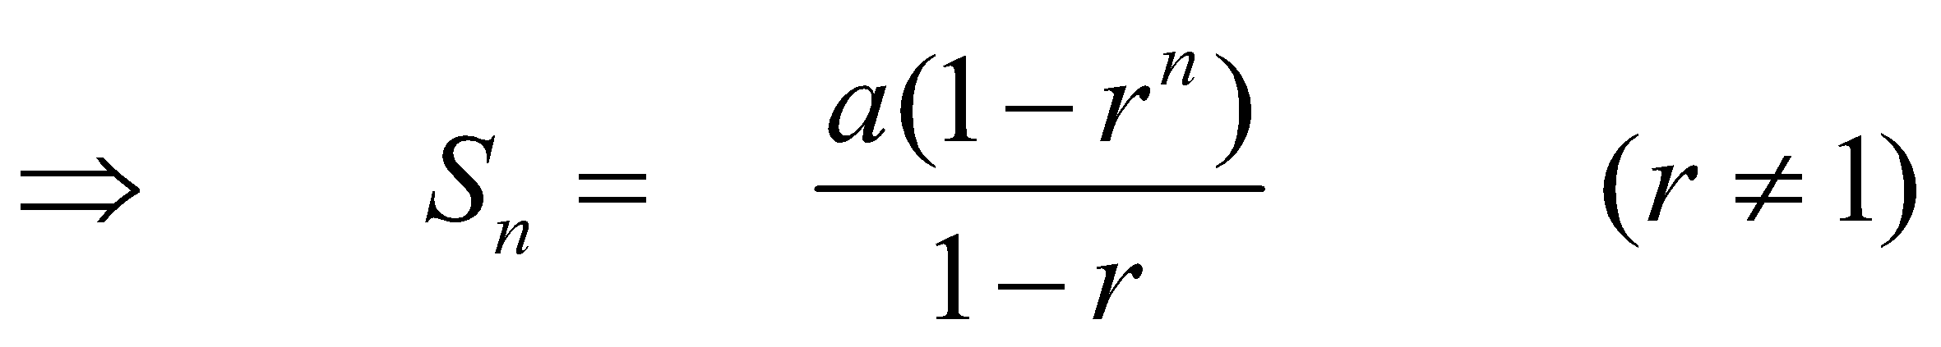
SUM OF n TERMS OF A GEOMETRIC SERIES
Let a be the first term and r be the common ratio of a geometric series. Then its nth term is:
a_{n} = ar^{n-1}; n ≥ 1
If S_{n} denotes the sum of first n terms of the G.S. then
S_{n} = a + ar + ar² + ar³ + … + ar^{n-2} + ar^{n-1}….(1)
Multiplying both sides by r we get.
r S_{n} = ar + ar² + ar³ + … + ar^{n-1} + ar^{n}….(2)
Subtracting (2) from (1) we get
S_{n} – rS_{n} = a – ar^{n}
⇒ (1 - r) S_{n} = a (1 - r^{n})

Slide 53
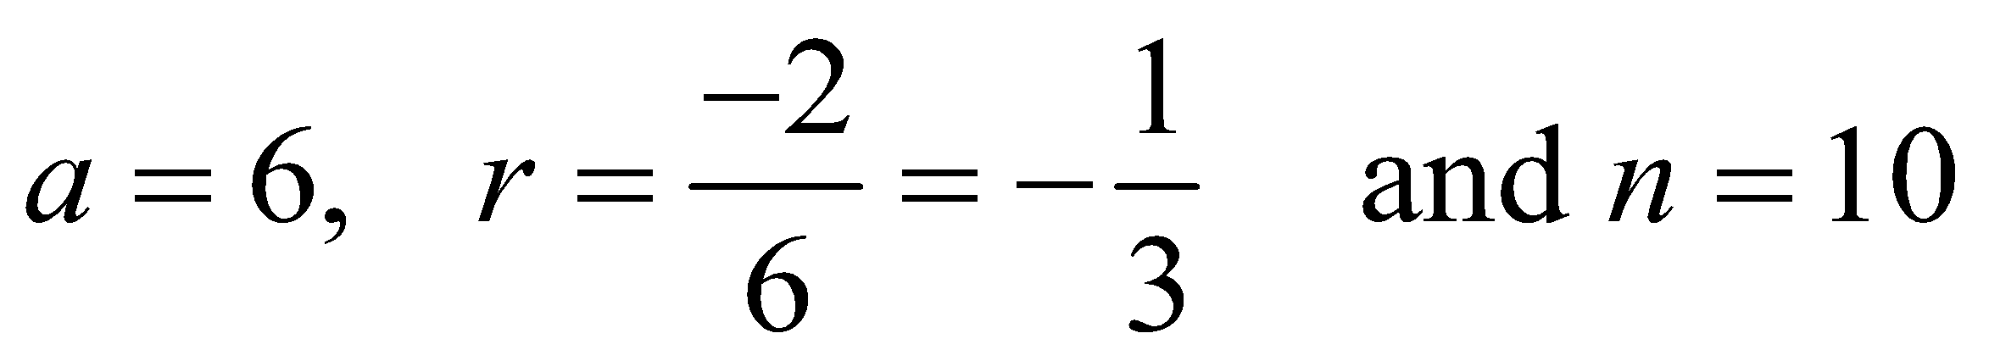
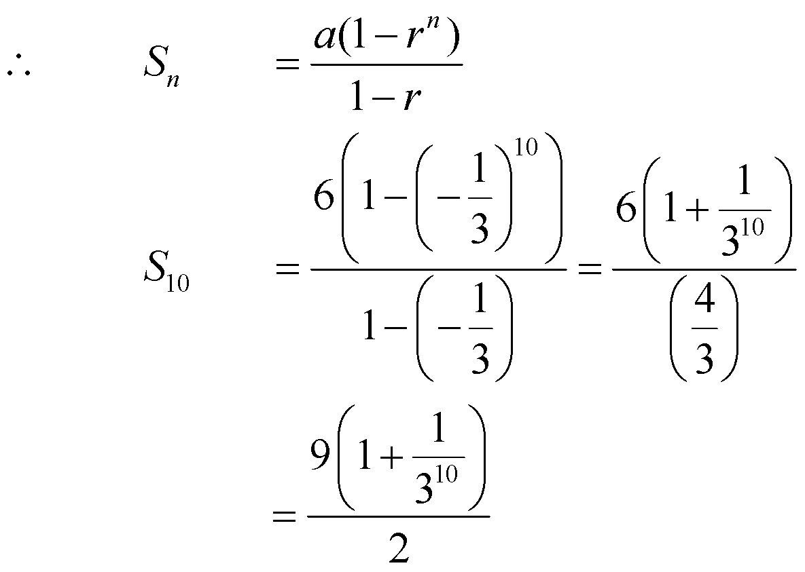
EXERCISE
Find the sum of the geometric series
SOLUTION

Slide 54
INFINITE GEOMETRIC SERIES
Consider the infinite geometric series
a + ar + ar2 + … + arn-1 + …
then
If S_{n} → S as n → ∞, then the series is convergent and S is its sum.
If |r| < 1, then r^{n} → 0 as n → ∞

Slide 55
GEOMETRIC SERIES SUM: EXAMPLE
Find the sum of the infinite geometric series:

Slide 56
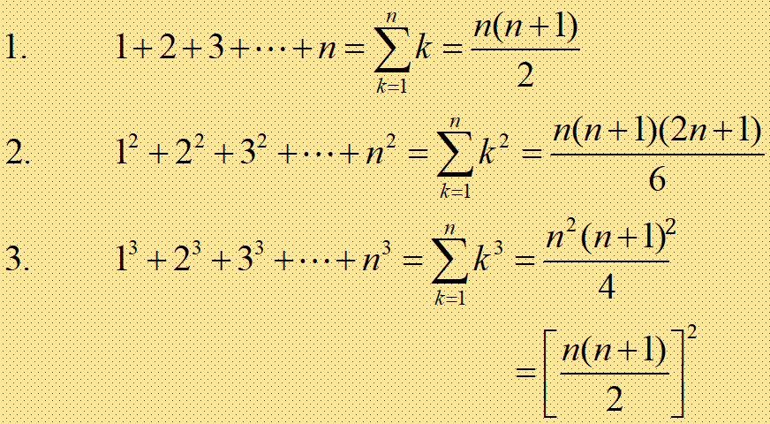
IMPORTANT SUMS

Slide 57

SERIES SUM: EXERCISE
Sum to n terms the series
1.5+5.11+9.17+…
Solution:
Lets write the nth term of given series
t_{k} = [a₀ + (k-1)d].[b₀ + (k-1)d]
= [1+(k-1)4].[5+(k-1)6]
= (4k-3).(6k-1)
= 24k²-22k+3
now
S_{n}=

Slide 58


Series Sum: Example
= (24k²-22k+3)
= 24 k² – 22 k + 3 1
= 24 (n(n+1)(2n+1))/6 – 22 (n(n+1)) / 2 + 3 n
= 4n (2n² + 3n + 1) - 11 (n² + n) + 3n
= 8n³ + 12n² + 4n - 11n² - 11n + 3n
= 8n³ + n² - 4n

Slide 59
RECURRENCE RELATION
A recurrence relation for a sequence a₀, a₁, a₂, . . . , is a formula that relates each term a_{k} to certain of its predecessors a_{k-1}, a_{k-2}, . . . , a_{k-i} , where i is a fixed integer and k is any integer greater than or equal to i.
The initial conditions for such a recurrence relation specify the values of a₀, a₁, a₂, . . . , a_{i-1}.

Slide 60
EXAMPLE
Let {a_{n}} be a sequence that satisfies the recurrence relation a_{n} = a_{n-1} +3 for n = 1, 2, 3, …, and suppose that
a₀ = 2. What are a₁ , a₂ , a₃ ?
Solution:
a_{n} = a_{n-1} +3
a₁ = a₀ +3
a₁ = 2 +3 = 5
a₂ = a₁ +3
a₂ = 5 +3 = 8
a₃ = a₂ +3
a₃ = 8 +3 = 11

Slide 61
EXAMPLE … Do it Yourself
Let {a_{n}} be a sequence that satisfies the recurrence relation a_{n} = a_{n-1} - a_{n-2} for n = 2, 3, 4, … and suppose that
a₀ = 3 and a₁ = 5. What are a₂ , a₃ ?
Solution:

Slide 62
EXAMPLE
Determine whether the sequence {a_{n}}, where a_{n} = 3n for every nonnegative integer n, is a solution of the recurrence relation that satisfies the recurrence relation a_{n} = 2a_{n-1} - a_{n-2} for n = 2, 3, 4, …
Solution:
Suppose that a_{n} = 3n for every nonnegative integer n.
a_{n} = 2a_{n-1} - a_{n-2}
So,
a_{n-1} = 3(n-1) and a_{n-2} = 3(n-2)
a_{n} = 2a_{n-1} – a_{n-2}
a_{n} = 2(3(n – 1)) – 3(n – 2)
a_{n} = 2(3n – 3) – 3n + 6
a_{n} = 6n – 6 – 3n + 6
a_{n} = 3n
So a_{n} = 3n is solution of recurrence relation.

Slide 63
EXAMPLE
Determine whether the sequence {a_{n}}, where a_{n} = 2^{n} for every nonnegative integer n, is a solution of the recurrence relation that satisfies the recurrence relation a_{n} = 2a_{n-1} - a_{n-2} for n = 2, 3, 4, …
Solution:
Suppose that a_{n} = 2^{n} for every nonnegative integer n.
a_{n} = 2a_{n-1} - a_{n-2}
So, a_{n-1} = 2^{n-1} and a_{n-2} = 2^{n-2}
a_{n} = 2a_{n-1} – a_{n-2}
a_{n} = 2. 2^{n-1} –2^{n-2}
a_{n} = 2^{n-1+1} – 2^{n-2}
a_{n} = 2^{n} – 2^{n-2}
So a_{n} = 2^{n} is not a solution of recurrence relation

Slide 64
EXAMPLE
Determine whether the sequence {a_{n}}, where a_{n} = 5 for every nonnegative integer n, is a solution of the recurrence relation that satisfies the recurrence relation a_{n} = 2a_{n-1} - a_{n-2} for n = 2, 3, 4, …
Solution:
Suppose that a_{n} = 5 for every nonnegative integer n.
a_{n} = 2a_{n-1} - a_{n-2}
So, a_{n-1} = 5 and a_{n-2} = 5
a_{n} = 2a_{n-1} – a_{n-2}
a_{n} = 2 . 5 – 5
a_{n} = 10 – 5
a_{n} = 5
So a_{n} = 5 is a solution of recurrence relation.

Slide 65
Some Useful Sequences

Slide 66
Some Useful Summations

Slide 67
Sequences & Summations … Exercises
How can we produce the terms of a sequence if the first 10 terms are 1, 2, 2, 3, 3, 3, 4, 4, 4, 4?
How can we produce the terms of a sequence if the first 10 terms are 5, 11, 17, 23, 29, 35, 41, 47, 53, 59?
How can we produce the terms of a sequence if the first 10 terms are 1, 3, 4, 7, 11, 18, 29, 47, 76, 123?
Conjecture a simple formula for an if the first 10 terms of the sequence {an} are 1, 7, 25, 79, 241, 727, 2185, 6559, 19681, 59047.

Slide 68
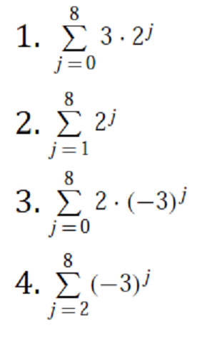
Evaluate the Summations … Exercises

Slide 69
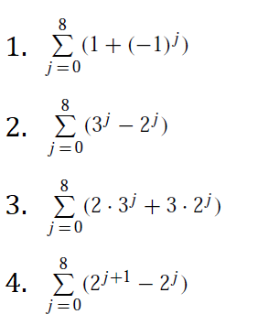
Evaluate the Summations … Exercises

Slide 70
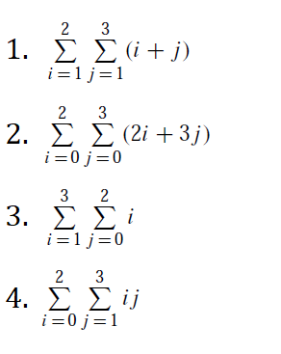
Evaluate the Summations … Exercises

Slide 71
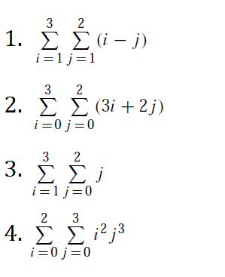
Evaluate the Summations … Exercises

Slide 72

Summary
The topics we covered:
Sequence (Definition, Notations, Example)
Arithmetic Progression (Generic Form, Example)
Geometric Progression (Generic Form, Example)
Summation (Computing, Examples)
Properties of Summation
Arithmetic Series
Sum of Series (Arithmetic, Geometric)
Infinite Geometric Series
Important Sums
Recurrence Relation
Practice Questions

